Slide 1
Why do decoding?
Use neural activity to control something
Neurally-controlled prostheses
Facebook F8 speech decoding
Learn something about how neural activity represents the world
Test a representation model
Observe representations change in interesting ways
Make sense of offline neural activity (hard)
Affect, attention
Hippocampal replay

Slide 2
Basic Assumption – “Encoding”
In order to DECODE, it must be the case that neurons are reliably ENCODING information.
Encoding model == Tuning Curve

Slide 3
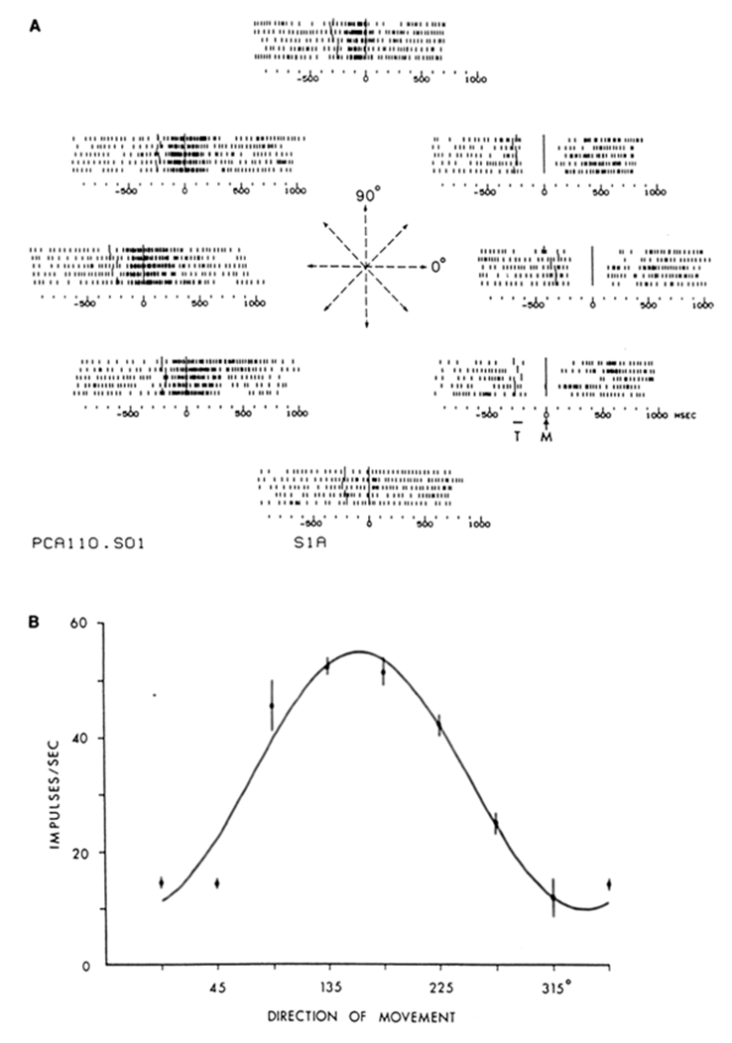
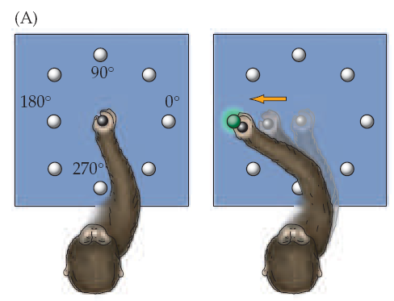

Example - M1 cells encode direction of movement
electrophysiology experiments by Apostolos Georgopoulos and others have shown that M1 cells fire before/during a movement and are tuned to movement direction.
Georgopoulos, A.P., et al., 1982, J of Neurosci. 2(11):1527-37
Notes:
Thilo mentioned that decoding methods were recent, but there are early examples. This one is intuitive.

Slide 4
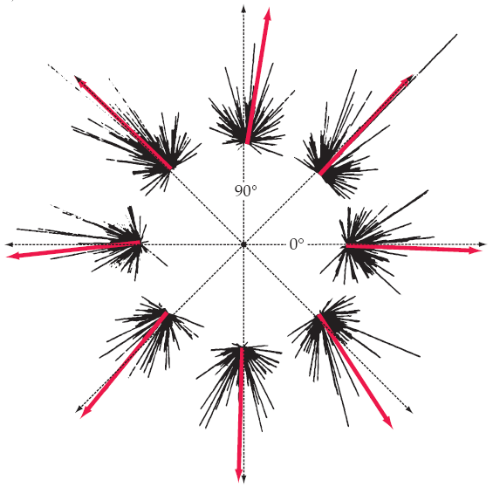
How do we combine data from multiple neurons?
Assign each neuron a vector pointing in its preferred direction scaled by its firing rate. The population vector is the sum of these vectors.
cosine tuning curve (single cell)
population vector
Neurons individually are not super precise. Precise estimation of movement direction requires summation of the signals of a population of motor cortex cells.
Such coding requires simultaneous activity over an array of cells and is referred to as “vector” or “population” coding.
Notes:
in the lower left plot, we are recording from a population of cells…
the population vector is the vector sum (weighted by firing rate) of the preferred directions of a population of neurons.
this is an example of a very simple, linear decoding: the firing rate of each neuron is directly proportional to the decoded dir

Slide 5
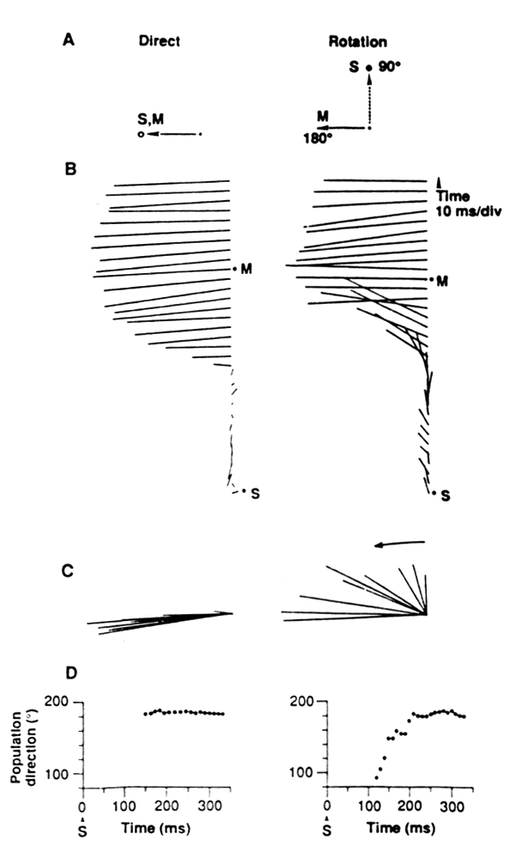
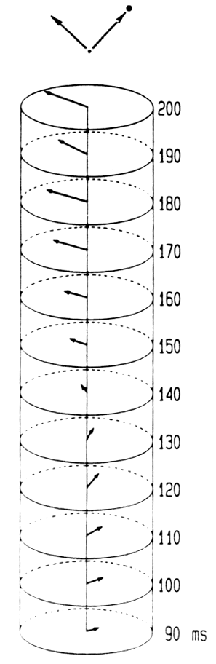
mental rotation of the neural population vector
In this task, a monkey had to make a movement 90 degrees from a cued direction.
Under these conditions, the movement vector initially points in the direction of the cue then rotates to the direction of the actual movement.
Georgopoulos, A.P. (1989) Science 243:234-237
Notes:
an early example of applying decoding methods to cognitive processing

Slide 6
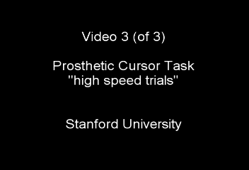
High-performance brain-controlled target selection
Approximately 5.0 bps (~10 words/min equivalent)
Santhanam, Ryu, Yu, Afshar & Shenoy, Nature 2006.

Slide 7
Decoding Algorithms
Supervised Learning
Minimize error!!
Continuous vs Discrete decoding (parametric vs nonparametric)
Probabilistic generative model of neural activity (Bayesian)
Probabilistic generative model of both neural activity and decoded variable (e.g., Kalman filter)
Unsupervised Learning
Techniques for when the variable being decoded is not known (e.g., EM algorithm, Hidden Markov Model).

Slide 8
Simple encoding model
A graphical model shows dependencies between variables.
Here “z” is the variable being decoded and each “n” is the binned activity of a single neuron.
Each arrow corresponds to a probabilistic relationship.
…

Slide 9
Simple encoding model
…
Showing data across time now.
“x” is a vector of neural activity.

Slide 10
Simple encoding model
Continuous
Discrete

Slide 11
Adding dynamics
Now we’ve added arrows to show that the decoded variable has dependency across time.
…
Note that the relationship across time is first-order Markov (no arrows from more than one step back). This is the assumption for simple Kalman filter-style decoding but is not necessary.

Slide 12
Common Population Observation Models
Gaussian (independent or correlated)
Poisson process (homogeneous, inhomogeneous)
Conditional intensity function (more complex dependence on history, variables) (e.g. Koyama et al 2010)

Slide 13
Common Decoding Techniques
Population vector (only makes sense if there’s really a “preferred direction”)
Independent Bayesian – invert Pr(x|z) (more complex for conditional intensity / GLM models)
Recursive Bayesian, various approximate filters (when decoded variable is connected across time)
Project into lower dimensional state then decode (e.g., Kao, et al 2015)

Slide 14
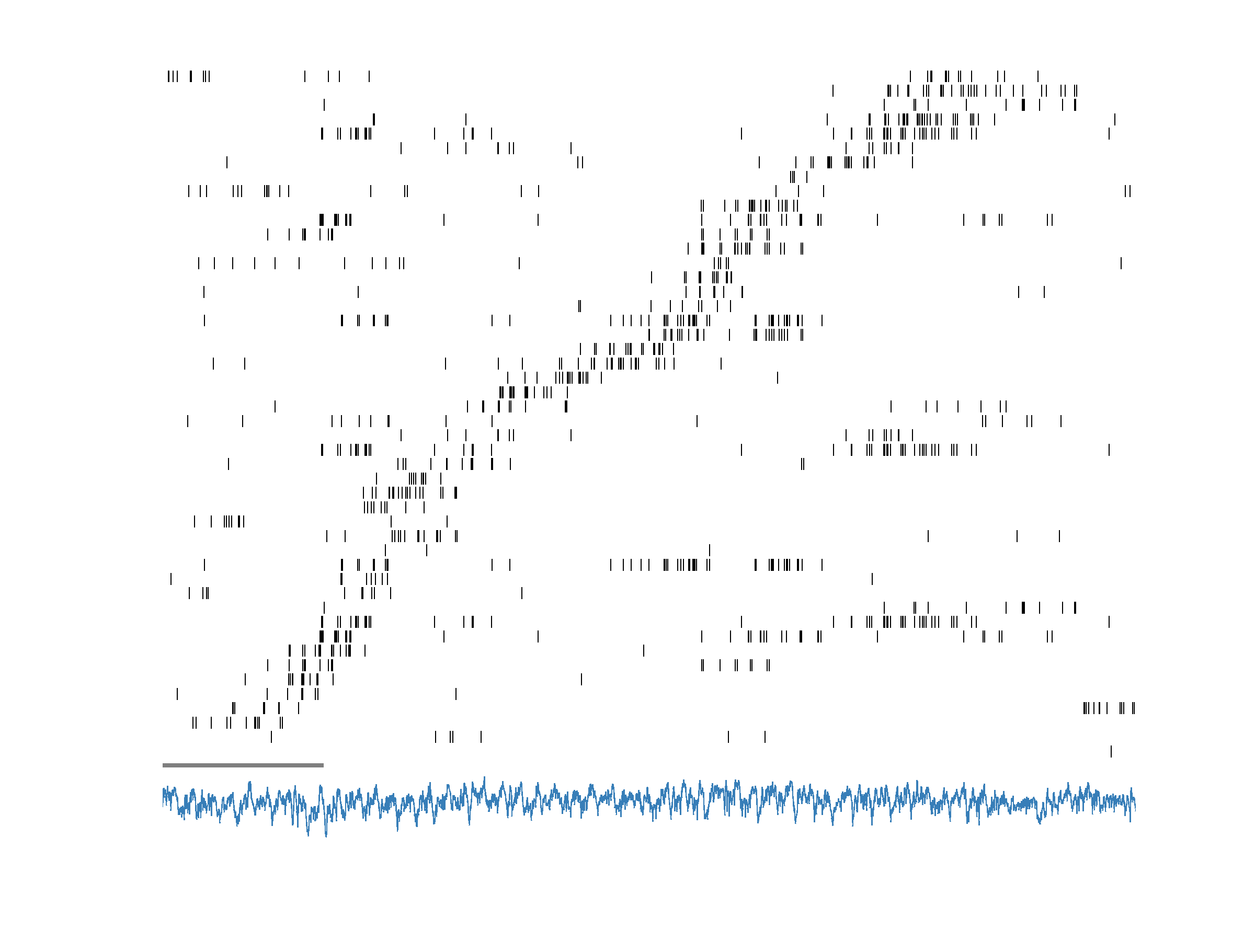
spatio-temporal sequence of place cell activity (behavioral timescale)
place field (ordered)
1s
LFP
time (~position)
data: van der Meer et al. (2017) Hippocampus
review: Pezzulo et al. (2017) NYAS
Notes:
as you know, the rat hippocampus generates highly structured neural activity
here is a rasterplot of some place cells as one of our rats runs a trial on a T-maze, you can see the sequential activation of one cell after another

Slide 15
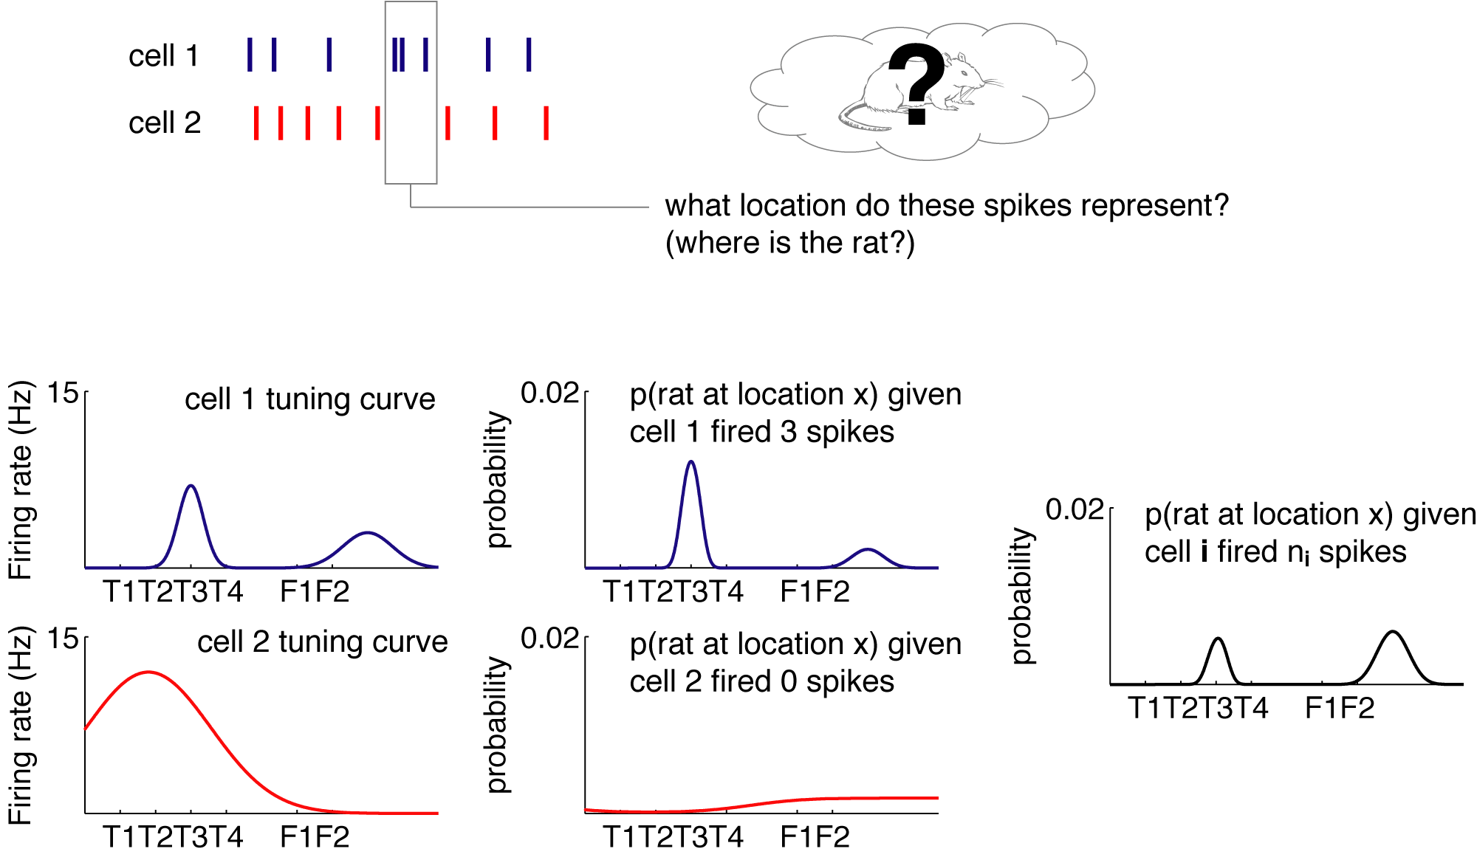
Notes:
This is a DECODING PROBLEM: given spikes, were is the rat?
To do that,

Slide 16
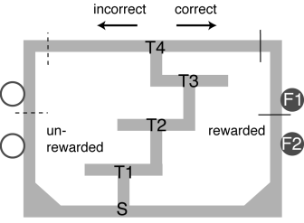
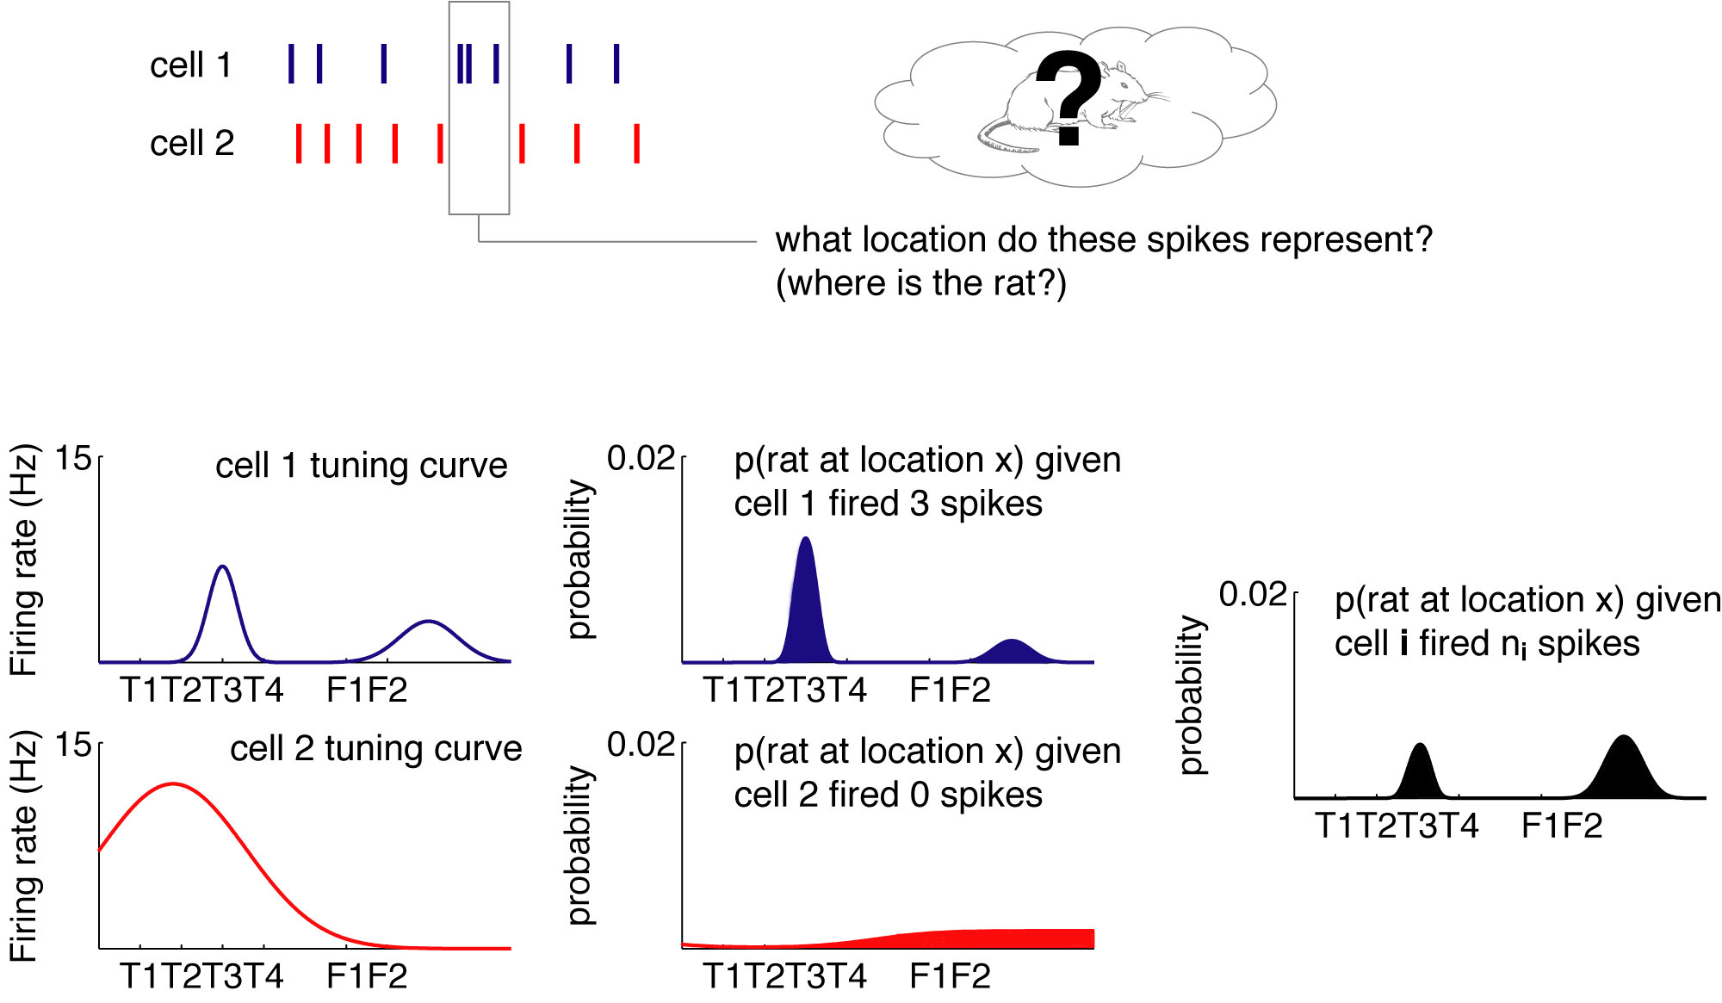
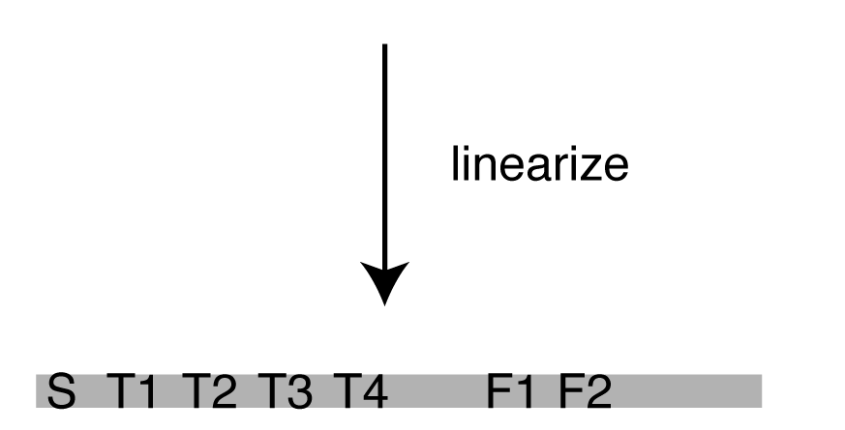
Notes:
..to do that, we take the cells’ overall tuning curves (so this one is active here.. And this one here..)

Slide 17
Poisson assumption
Notes:
then, based on how many spikes each cell fired, you get a probability distribution of the rat’s location on the track.
this is pretty intuitive: if you know this cell fired 0 spikes, you’d say the rat is more likely to be here (point) than here.
and this is what you see.
(this incidentally is one of the reasons why this method is simple: to compute this p distr it assumes poisson firing statistics.)

Slide 18
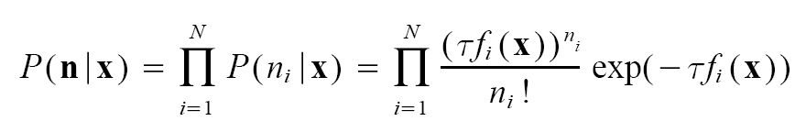
Independence assumption
Zhang et al. 1998
Brown et al. 2005
Notes:
a few things to say:
in a sense we take the position of a downstream brain area, that gets information about the state of the world, *or of an internal state*
retrieve WHAT THAT STATE IS… a single trial approach

Slide 19
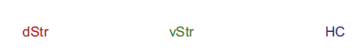
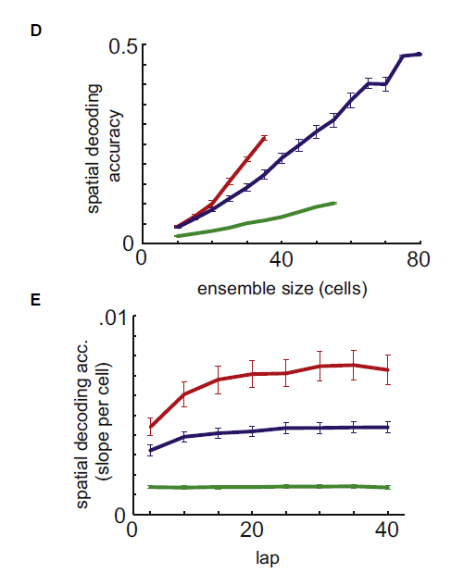
van der Meer et al. (2010) Neuron
Notes:
one application is “how well” you can decode certain things, how much every extra cell helps…
in this sense, quite similar to the questions addressed with information theory.

Slide 20
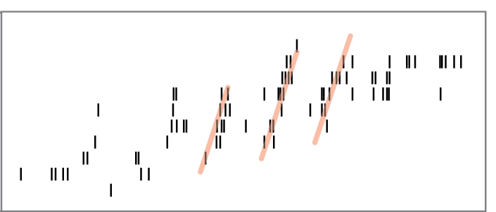
spatio-temporal sequence of place cell activity (theta timescale)
place field (ordered)
1s
LFP
time (~position)
data: van der Meer et al. (2017) Hippocampus
review: Pezzulo et al. (2017) NYAS
Notes:
…segments of that behavioral sequence appear in a repeated, compressed manner at the theta timescale..

Slide 21
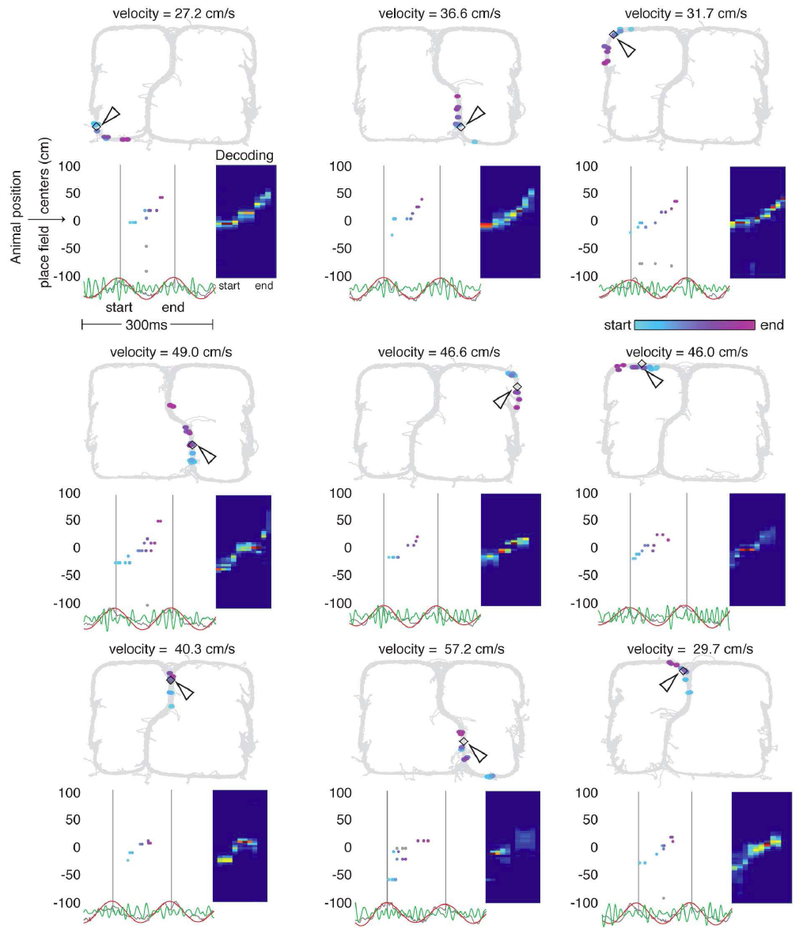
Gupta, van der Meer et al. (2012) Nature Neuroscience
Notes:
(2) a different question: not “how well” we can decode something, but what the content is.
not how much information, but what information.

Slide 22
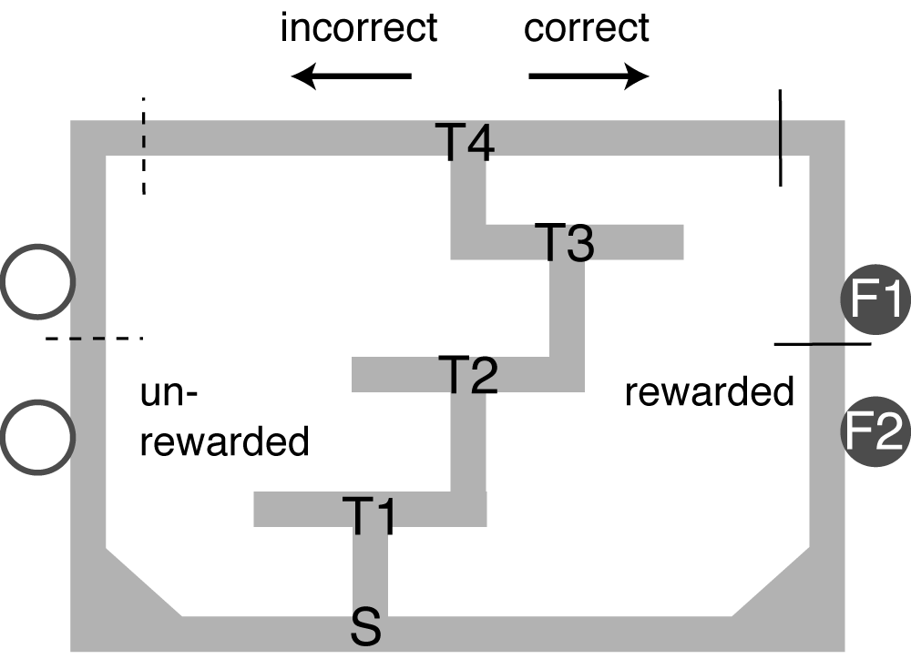
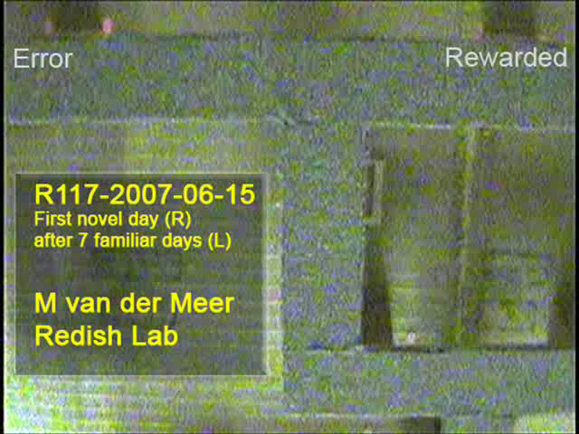
The Multiple-T maze: a simple binary spatial decision task
Version 1: sequence of turns and rewarded side is constant on a given day (session), but changes between sessions.
Version 2: reward contingencies switch midway through each session (left, right, alternate)
“vicarious trial-and-error”
Notes:
for this tutorial, different data

Slide 23
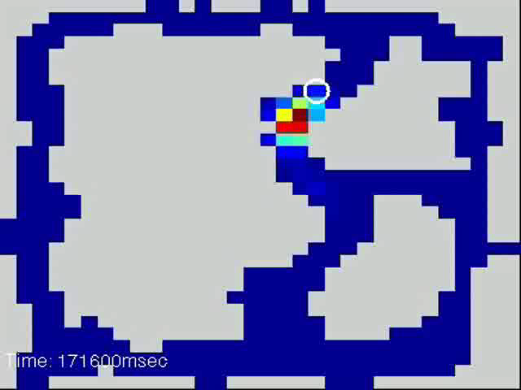
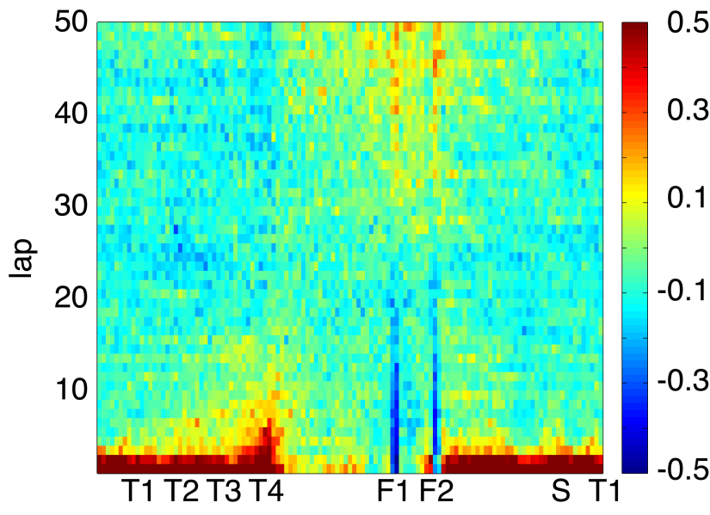
Johnson and Redish, J Neurosci 2007
“vicarious trial-and-error”
time spent (normalized)
Notes:
Here is a video illustrating what our best guess looks like in small (20 milliseconds) time steps.
Red color means rat is likely to be there. Actual location of the rat is the white circle.
watch what happens as he pauses at the choice point. [notice, initially decoding is local, but at the choice point it goes forward left, then right.]
NOTE that this is EXACTLY WHAT WE WOULD WANT FROM A FLEXIBLE PLANNING SYSTEM!
I then showed, IN A PAPER IN PRESS AT NEURON, that

Slide 24
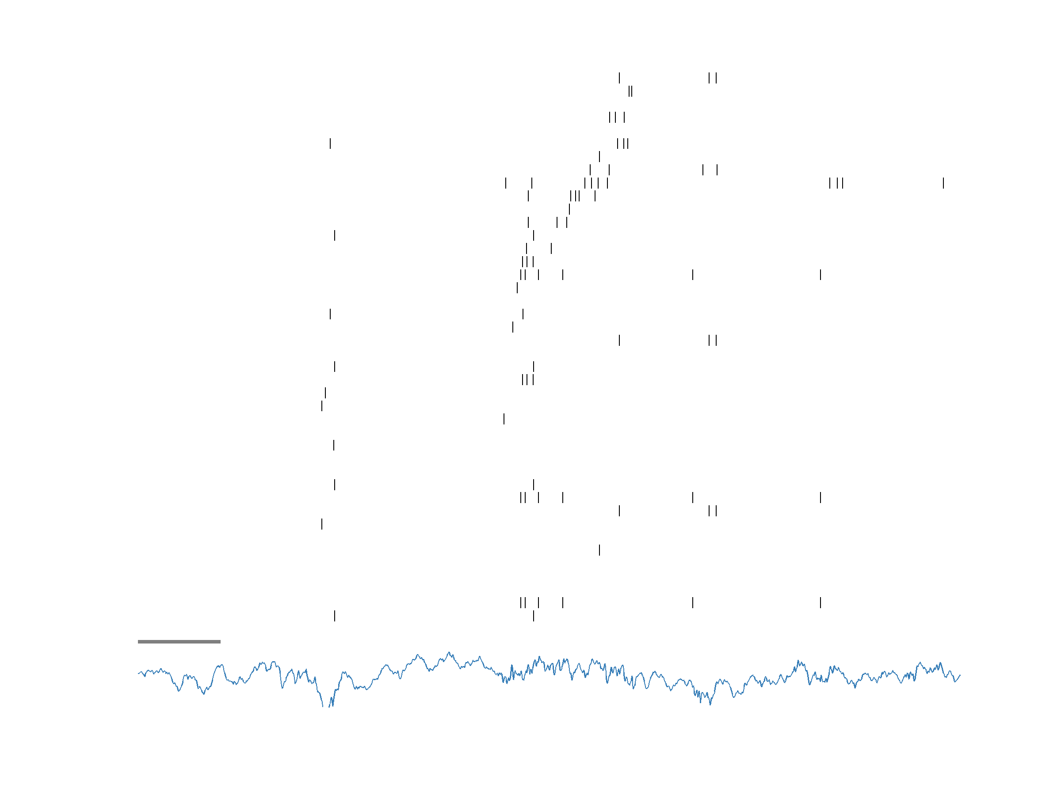
spatio-temporal sequence of place cell activity (during rest)
place field (ordered)
100ms
LFP
time
data: van der Meer et al. (2017) Hippocampus
review: Pezzulo et al. (2017) NYAS
Notes:
and finally here is an example of a SWR-sequence

Slide 25
theta sequences
continuously repeating
during active behavior
mostly forward, then reset
local
initial memory trace storage
memory retrieval, planning?
sharp wave-ripple (SWR) sequences (“replay”)
episodic
during rest, slow-wave sleep
forward, backward
local, remote
systems consolidation
memory retrieval, planning?
Notes:
these SWR sequences have some interesting properties, and are thought to support..
WE VIEW THESE FUNCTIONS AS ARISING FROM A GENERATIVE MODEL THAT LEARNS TO GENERATE PREDICTIONS ABOUT THE WORLD

Slide 26
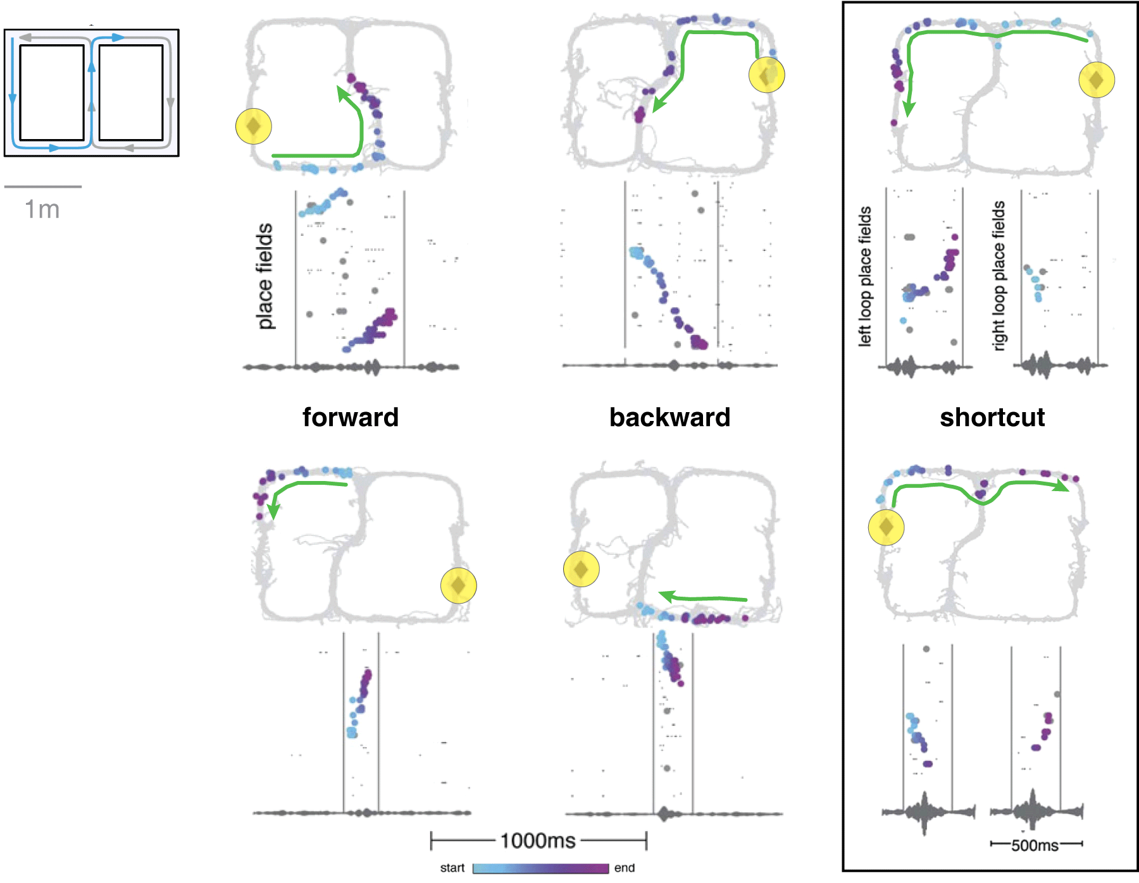
sharp wave-ripple (SWR) sequences depict never-experienced shortcuts
Gupta, van der Meer, Touretzky, Redish (2010)
Notes:
not due to chance alignment of independent replays.

Slide 27
sharp wave-ripple (SWR) sequences depict never-experienced shortcuts
Gupta, van der Meer, Touretzky, Redish (2010)
Notes:
not due to chance alignment of independent replays.

Slide 28
SWR sequences are preferentially directed towards a goal location
Pfeiffer & Foster, Nature (2013)

Slide 29
SWR sequences are preferentially directed towards a goal location
Pfeiffer & Foster, Nature (2013)

Slide 30
accessing SWR sequence content
1s
run
Notes:
this is often thought of as a (1-D in this case) neural correlate of memory recall
note compressed timescale!

Slide 31
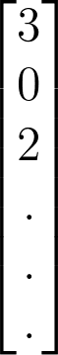
accessing SWR sequence content
1s
run
position
position
position
vector of spike counts
Notes:
a typical thing to do is to apply a probabilistic decoding procedure that based on observed spike counts AND TUNING CURVES gives probabilities of rat being at different positions.

Slide 32
accessing SWR sequence content
1s
run
position
position
position
actual
(observed)
position
vector of spike counts
Notes:
if the rat is running, can compare this to the actual (observed) position to know if you’re doing the decoding right.

Slide 33
accessing SWR sequence content
1s
run
decoded position
can be compared to ground truth
(actual position)
Notes:
if the rat is running, can compare this to the actual (observed) position to know if you’re doing the decoding right.

Slide 34
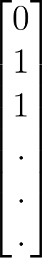
accessing SWR sequence content
1s
100ms
covert
run
decoded position
can be compared to ground truth
(actual position)
decoded position
can be compared to ???
(no ground truth)
Notes:
but for SWR-sequences, you can’t do that.

Slide 35
accessing SWR sequence content
1s
100ms
covert
run
decoded position
decoded position
this mapping (neural code) is unlikely to be the same between overt and covert activity

Slide 36
accessing SWR sequence content
1s
100ms
covert
run
decoded position
decoded position
this mapping (neural code) is unlikely to be the same between overt and covert activity
least we can do: optimize for generalization (i.e. cross-validation; performance on held out data)
Notes:
this is often thought of as a (1-D in this case) neural correlate of memory recall
note compressed timescale!

Slide 37
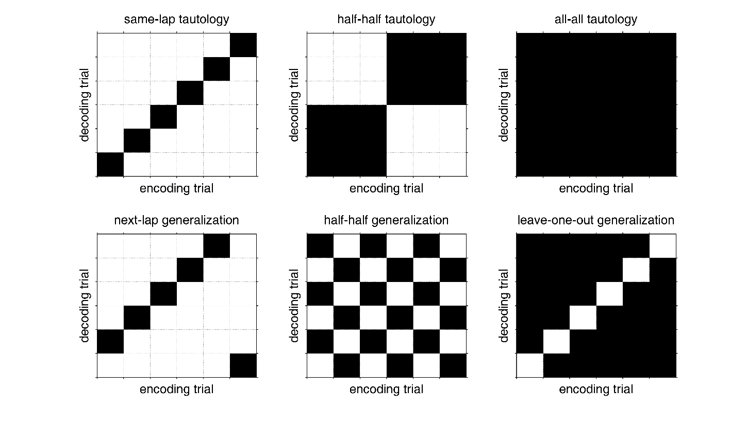

decoding with and without cross-validation
van der Meer, Carey, Tanaka (2017) Hippocampus
Notes:
so, should we just give up?

Slide 38
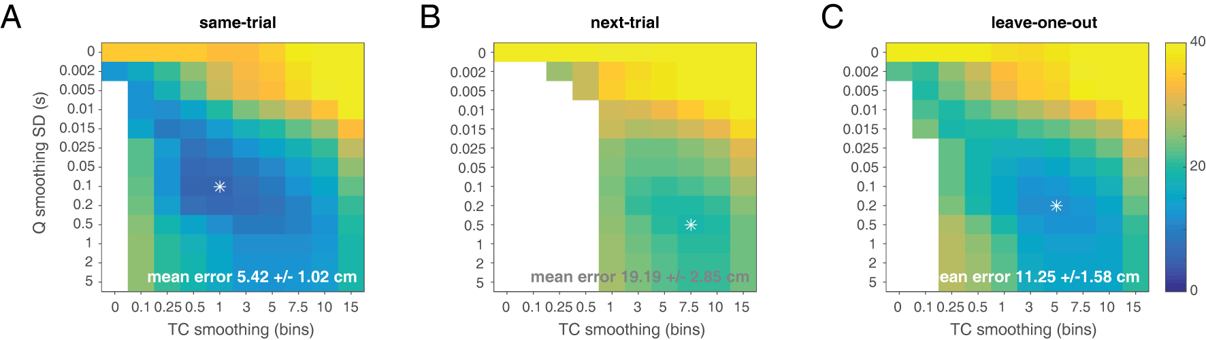
decoding with and without cross-validation
van der Meer, Carey, Tanaka (2017) Hippocampus
Notes:
lower error is better
note effects of smoothing spike trains and tuning curves; even with very minimal smoothing, can do better

Slide 39
decoding with and without cross-validation
cross-validated and same-trial decoding result in different mean decoding errors
van der Meer, Carey, Tanaka (2017) Hippocampus
Notes:
this is not surprising… could be overfitting

Slide 40
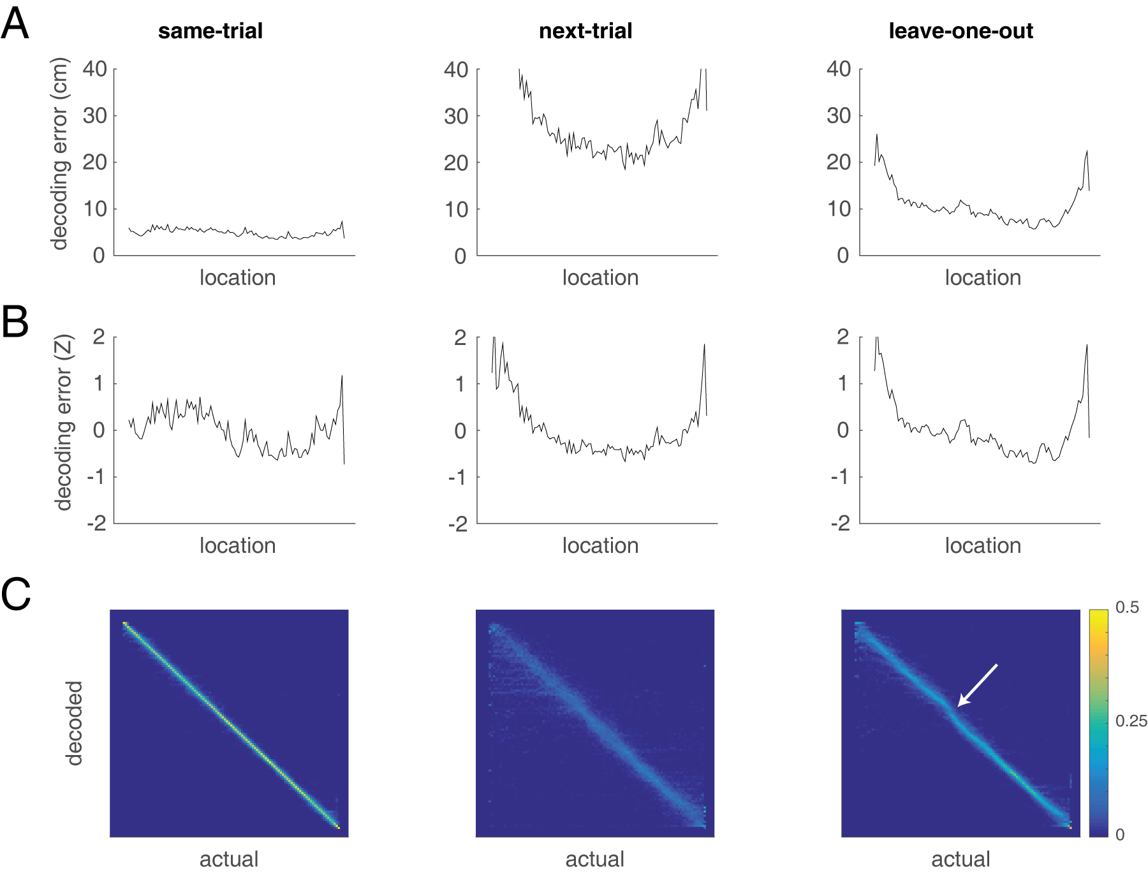
null hypotheses for SWR sequence content
cross-validated and same-trial decoding result in different distributions of decoding accuracy over space
cross-validated decoding is a better null hypothesis for replay content!
van der Meer, Carey, Tanaka (2017) Hippocampus
Notes:
use encoding model with best generalization performance
key point: suppose you were going to decode putative “prospections” and found they were biased at the choice point…

Slide 41
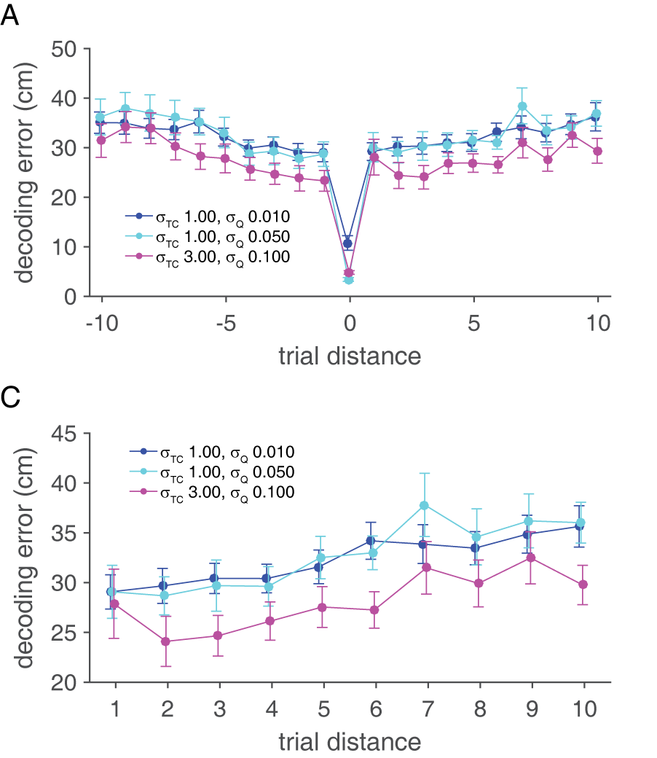
overfitting alone does not explain temporal distance effects on decoding error
if overfitting of trial-unique noise was the only cause of decoding error, then decoding error should not depend on which trial is used for decoding…
but decoding error continues to depend on “trial distance” even after regressing out contributions of behavioral variables
→ suggests encoding of temporal context?
van der Meer, Carey, Tanaka (2017) Hippocampus
Notes:
this is not surprising… could be overfitting

Slide 42
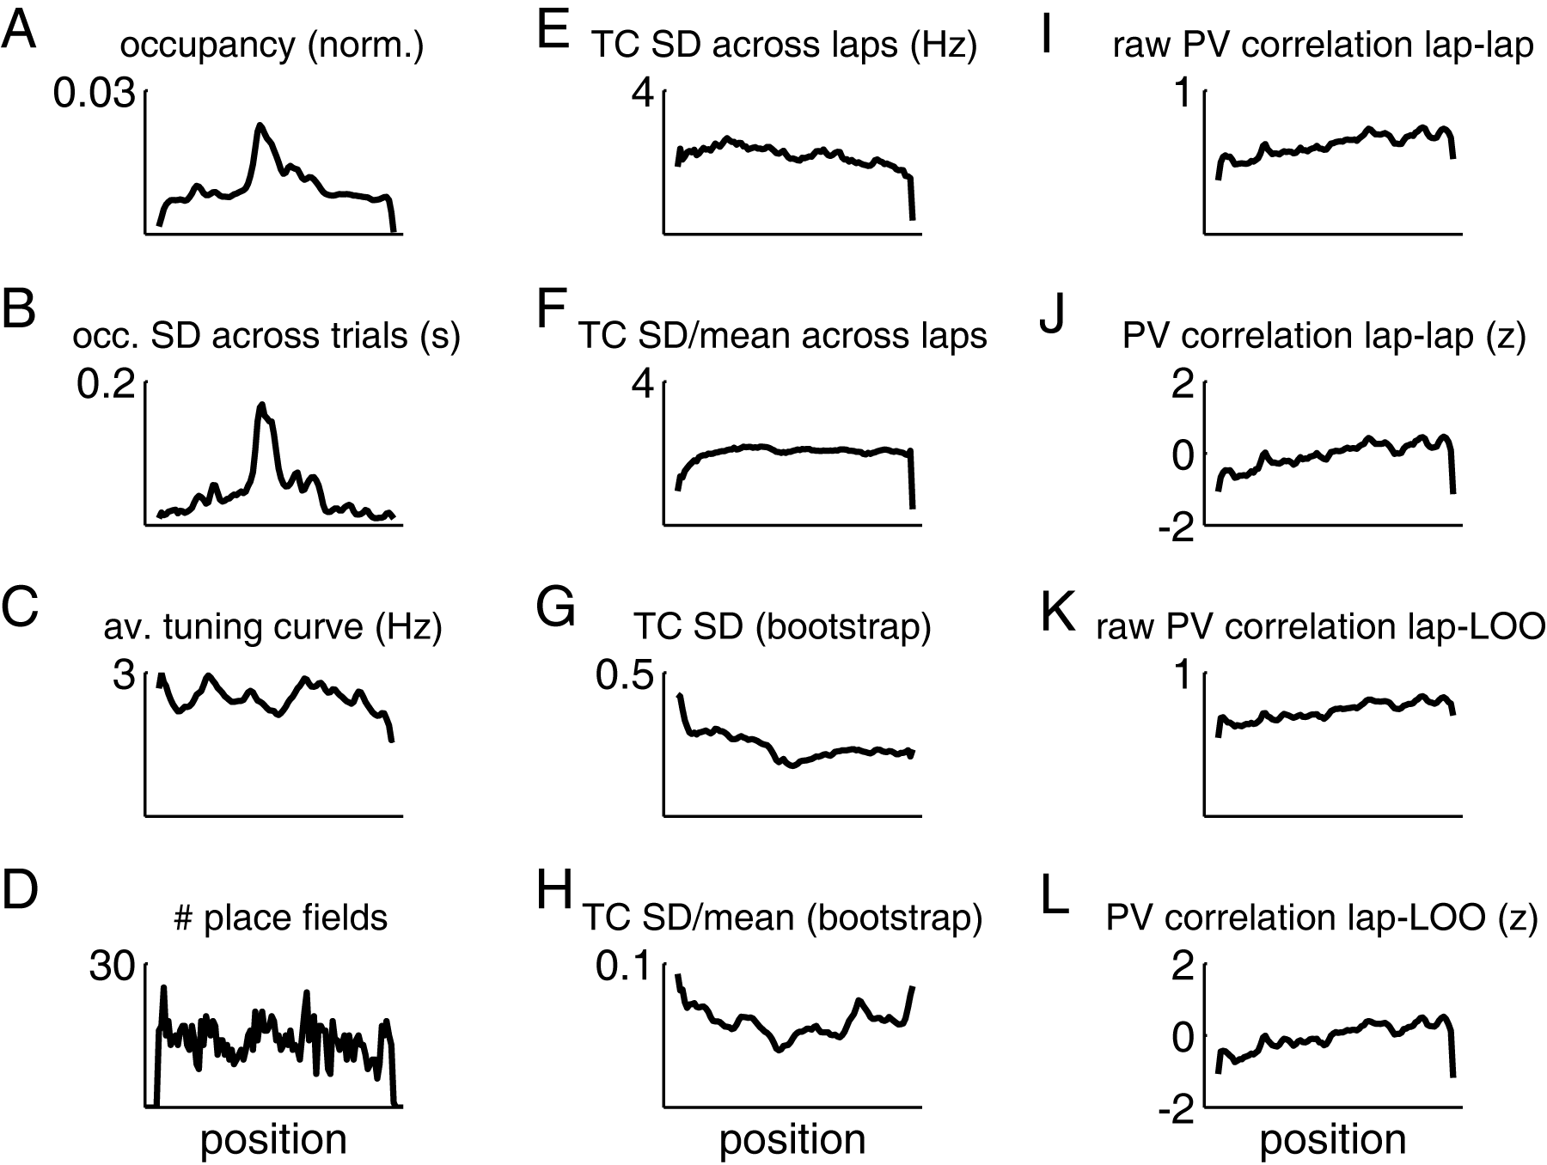
what contributes to cross-validated decoding error?
van der Meer, Carey, Tanaka (2017) Hippocampus
Notes:
Figure 9: Among several behavioral and neural measures, tuning curve variability as estimated
by a bootstrapping procedure is most similar to cross-validated decoding accuracy. A: Normalized
occupancy (time spent) and its standard deviation across trials within each session (B). C:
Mean firing rate of all cells with at least one place field, and distribution of place field peaks (D).
E: Standard deviation of single-trial tuning curves, computed across trials within a session (raw) or
normalized by the mean (F). G: Entire-session tuning curve variability, estimated by a bootstrapping
procedure (raw) or normalized by the mean (H). I: Raw, and z-scored (J) population vector
correlation between tuning curves estimated across every pair of trials. K: Raw, and z-scored (L)
population vector correlation between tuning curves estimated from each trial and the complementary
leave-one-out tuning curves.

Slide 43
what is the correct null hypothesis for SWR-sequence content?
(published)
decoding accuracy obtained from cross-validated decoding, which is different from that obtained from tautological decoding!

Slide 45
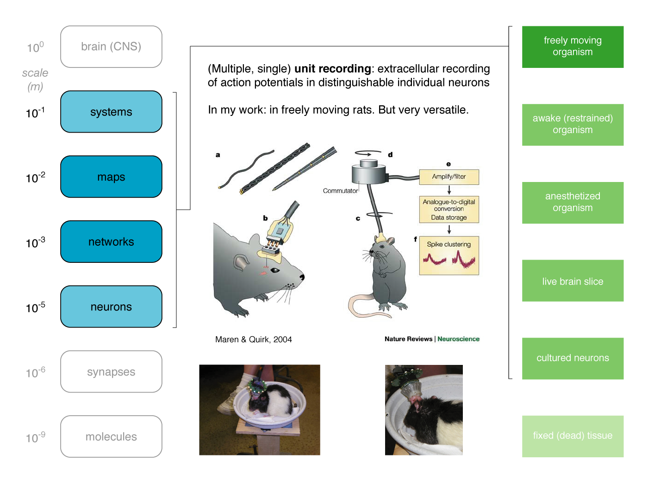
Notes:
45
The basic idea is to place electrodes in the brain, and record the activity of neurons --
this is a very versatile technique, can be applied in a range of “preparations” cultured neurons to freely moving animals (including humans).
The big advantage is that you can study brain activity in the intact brain, down to the level of activity in a single neuron. By recording from many neurons across brain areas you can make a bridge from neurons to systems.

Slide 46
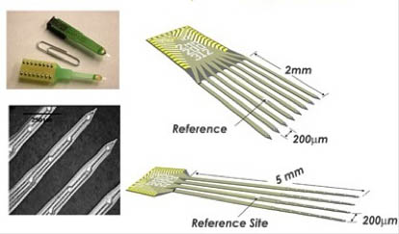
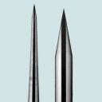
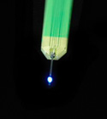
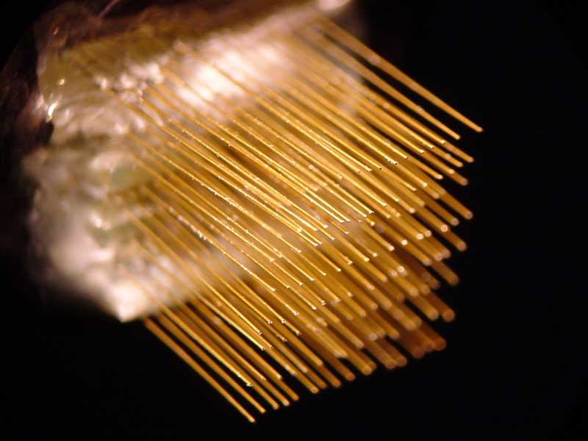
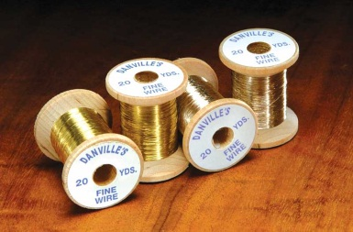
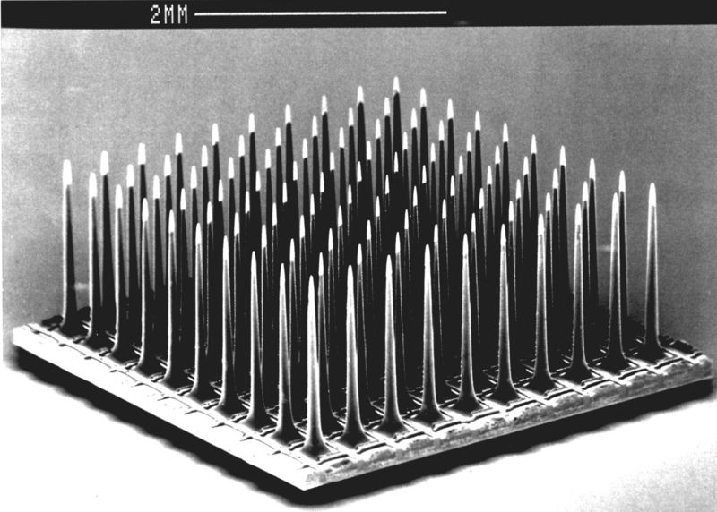
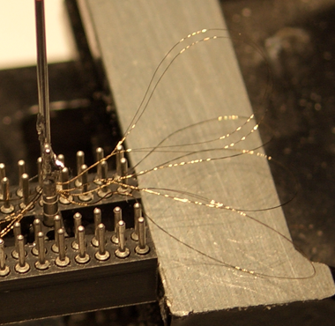
1 electrode
optrode
2 pre-processing
(filtering, thresholding)
sharp electrodes
NeuroNexus (“Michigan”) probes
3 spike sorting
4 analysis
Nicolelis lab
array
electrode
diversity
microwire
brain-electrode
interface
tetrodes
the “hyperdrive”
Utah array
Notes:
46
there are many different kinds of electodes! for different purposes…

Slide 47
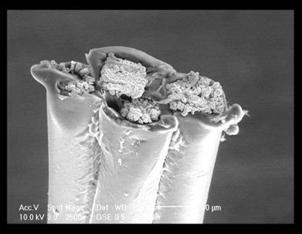
1 electrode
2 pre-processing
(filtering, thresholding)
Matt Jones
3 spike sorting
4 analysis
electrode
diversity
brain-electrode
interface
the “hyperdrive”
SEM image of gold-plated tetrode tip
Notes:
47
this shows an important one, the tetrode. you can see, it has 4 recording sites. I will explain why in a few minutes.
This image shows the recording sites are plated; this is important to improve recoding surface and thus signal to noise..

Slide 48
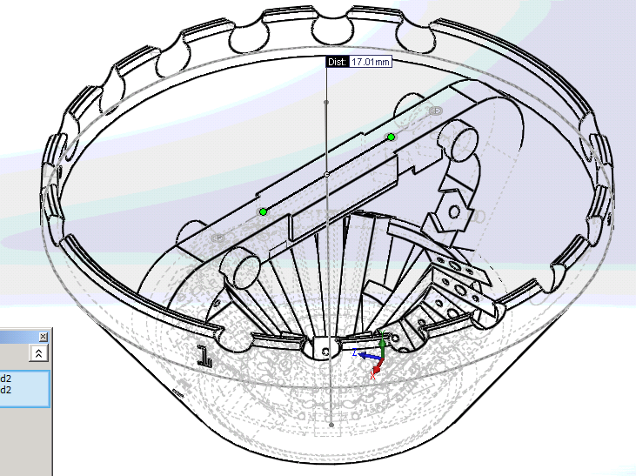
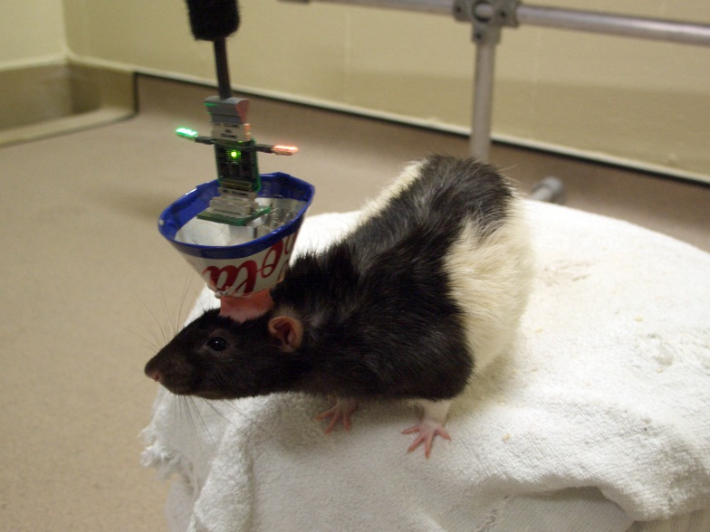
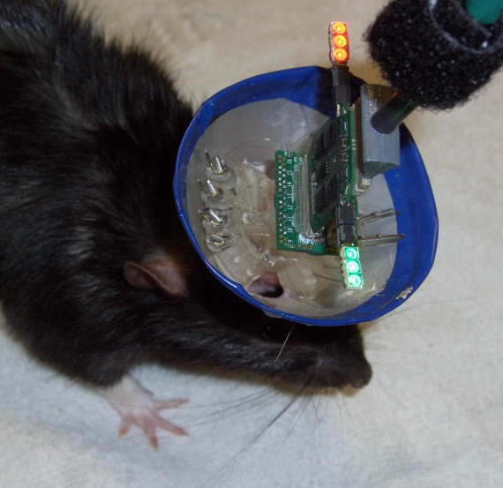
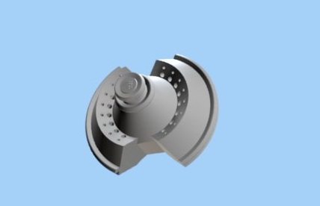
1 electrode
vandermeerlab Feb 2012
2 pre-processing
(filtering, thresholding)
3 spike sorting
4 analysis
electrode
diversity
brain-electrode
interface
Features:
- Independently movable tetrodes (above, up to 16)
- Flexible layout for multiple targets
the “hyperdrive”
Notes:
48

Slide 49
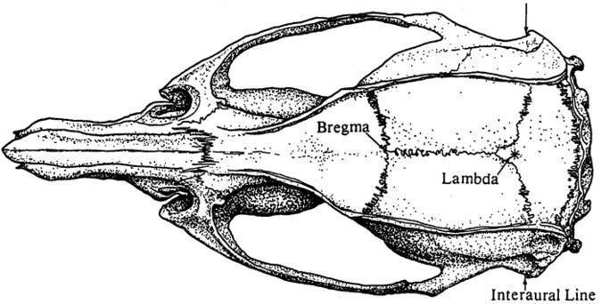
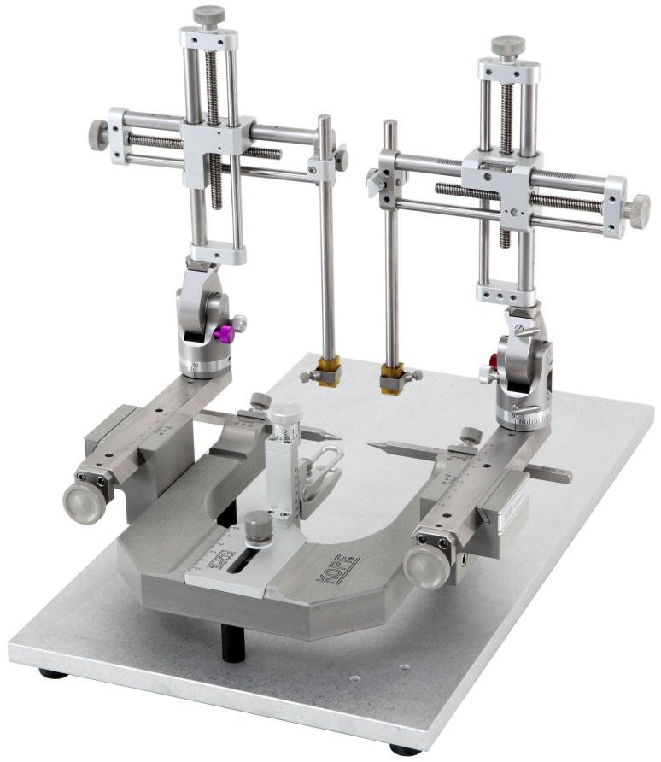
Implanting electrodes into the brain: stereotactic surgery
Skull landmarks
Stereotactic frame & arms
(missing: anesthesia, …)
Notes:
49
How do you actually get the electrodes into the brain? where you want them?
skull has landmarks.
can measure distances from those using a “stereotax”

Slide 50
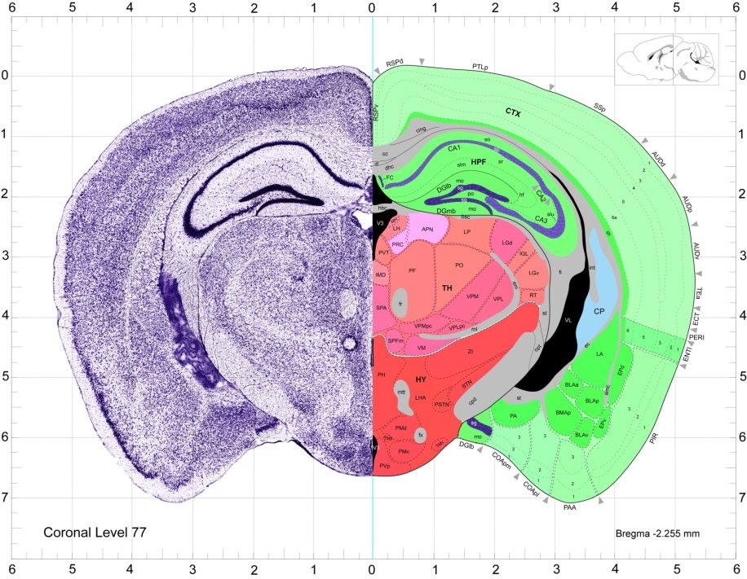
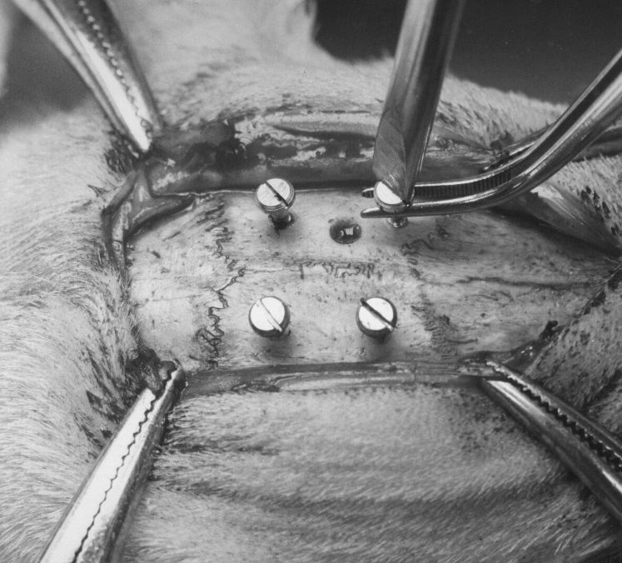
Implanting electrodes into the brain: stereotactic surgery
What it actually looks like..
Brain atlas
Cooley & Vanderwolf, 2005
Notes:
50
then you can use a brain atlas for some initial targeting guidelines.
also, if you have a hyperdrive, you can move the electrodes later (but only up and down..!)
here is a picture showing skull landmarks, a craniotomy, and some anchor screws.

Slide 51
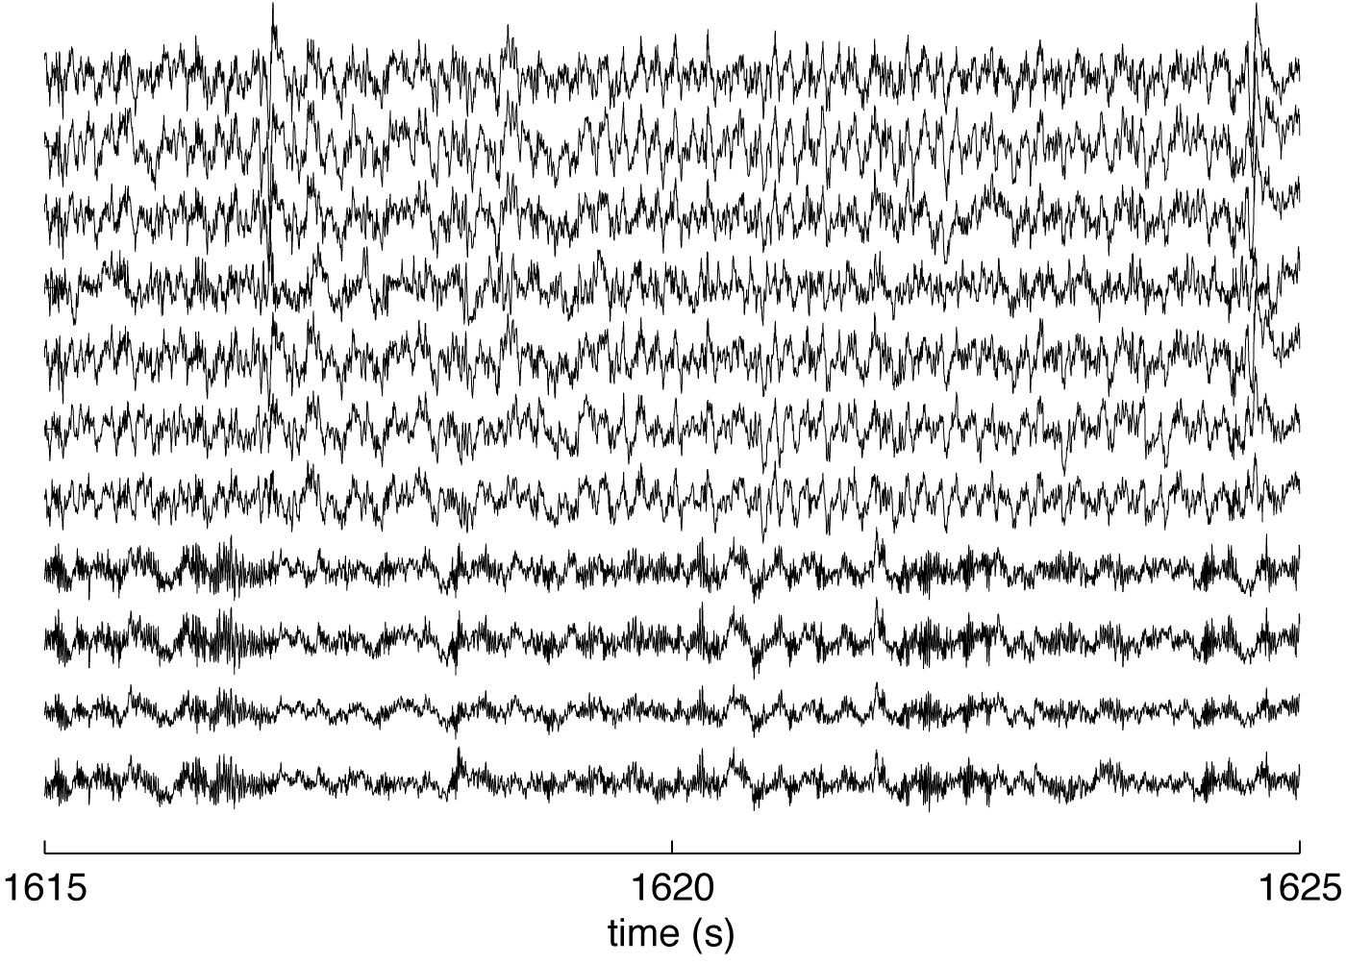
1 electrode
raw data
voltage trace
2 pre-processing
(filtering, thresholding)
1-475 Hz filter
600 Hz - 6 kHz filter
3 spike sorting
field potentials
action potentials
(single neuron spikes)
4 analysis
Notes:
51
so, if you do all of this correctly, then congratulations, you will be able to record a voltage trace from the brain!
you can process this in different ways.
LFP: lower frequency signal reflecting activity of many neurons together, mostly dendritic currents from synaptic inputs, subthreshold potentials
spikes

Slide 52
Notes:
here are some LFPs recorded using a hyperdrive. what a mess!

Slide 53
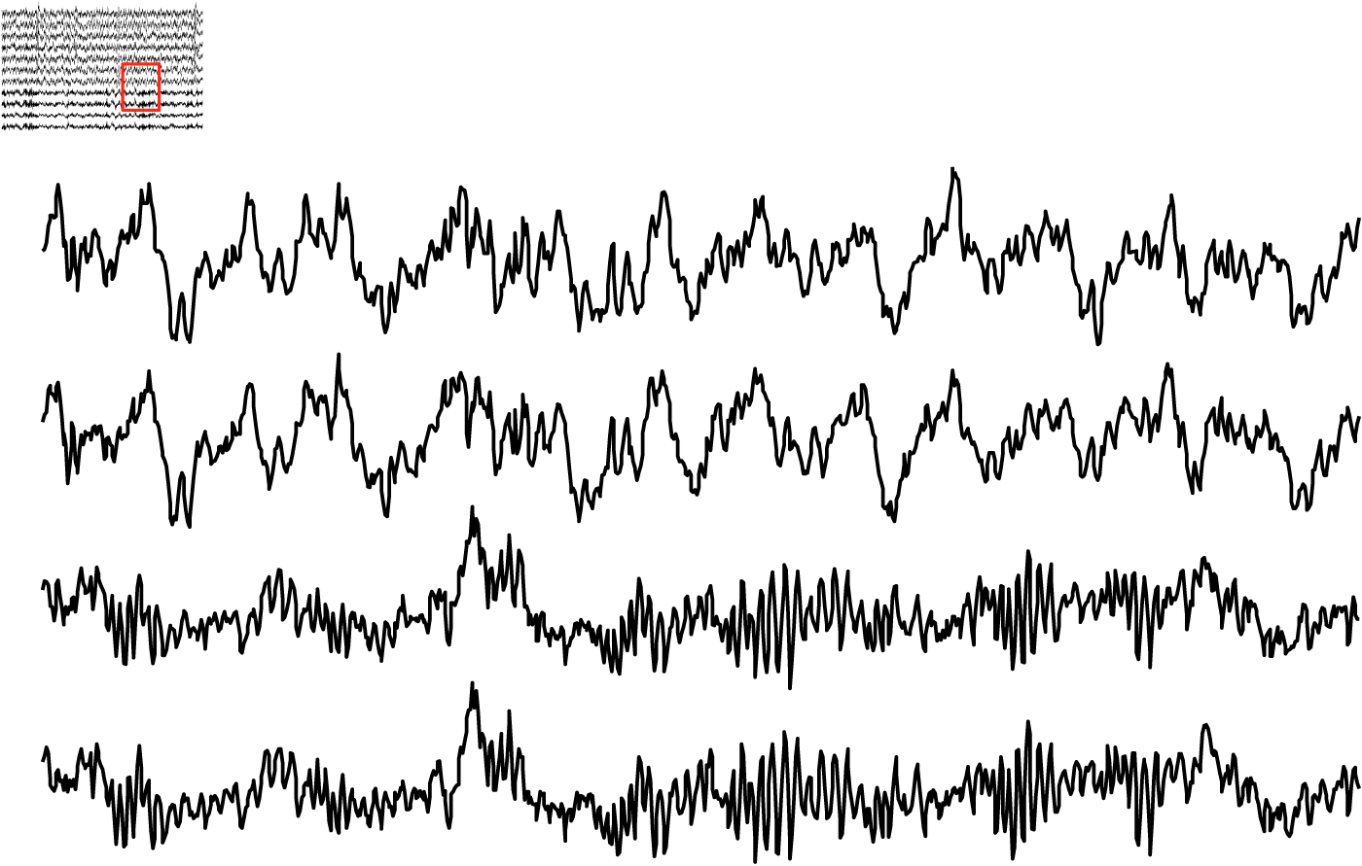
field potential recordings with theta (top 2 traces) and gamma (bottom 2 traces) rhythms
Notes:
but actually, zooming in, you can see some interesting structure.
these gamma oscillations, for instance, are thought to be involved in “binding through synchrony”.
example: you see something that’s red and square.. but maybe you have different neurons for those things. how does the brain know they go together?

Slide 54
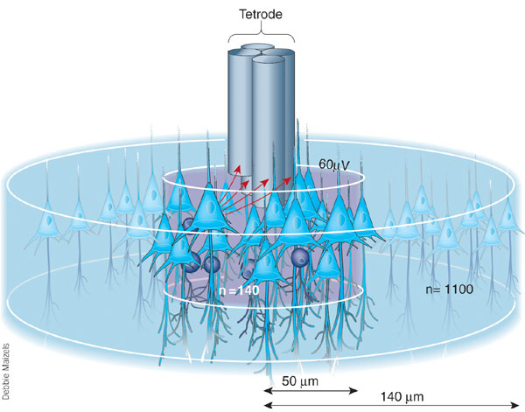
1 electrode
raw data
voltage trace
2 pre-processing
(filtering, thresholding)
1-475 Hz filter
600 Hz - 6 kHz filter
3 spike sorting
field potentials
action potentials
(single neuron spikes)
4 analysis
Notes:
54
So what about the spikes? This is where the tetrode comes in.

Slide 55
2
3
1 electrode
1
4
2 pre-processing
(filtering, thresholding)
3 spike sorting
4 analysis
Notes:
55

Slide 56
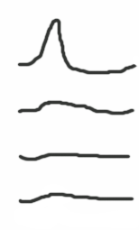

2
3
1 electrode
1
4
2 pre-processing
(filtering, thresholding)
3 spike sorting
4 analysis
1
2
3
4
1
2
3
4
Notes:
56

Slide 57

1 electrode
waveform features form “clusters”
(each dot is a single waveform recorded across 4 wires)
2 pre-processing
(filtering, thresholding)
3 spike sorting
4 analysis
putative neuron
(“cluster”) 1
putative neuron
(“cluster”) 2
1
2
3
4
1
2
3
4
Notes:
57

Slide 58
1 electrode
waveform features form “clusters”
(each dot is a single waveform recorded across 4 wires)
2 pre-processing
(filtering, thresholding)
3 spike sorting
4 analysis
putative neuron
(“cluster”) 1
putative neuron
(“cluster”) 2
1
2
3
4
1
2
3
4
Notes:
58

Slide 59


histology: where was the recording from?
Ainge et al. 2007
cryostat
coronal (40um) brain slice, rat hippocampus
Notes:
59

Slide 60

1 electrode
output of the whole thing:
2 pre-processing
(filtering, thresholding)
3 spike sorting
1. spike times of (putative) single neurons
4 analysis
2. field potentials
… from a freely moving animal
Notes:
60

Slide 61


relating neural activity to behavior:
place cell
“place field”

Slide 62
Unsupervised Learning (HMM) Example
Learn a discrete state Hidden Markov model from ripple activity

Slide 63
What do the states represent?
Decode activity during running and assign location to latent state. This yields a “virtual tuning curve” for each state.

Slide 64

Observation Model
Notes:
\begin{equation*}
\mathbf{x}_t \vert \mathbf{z}_{t} \sim \mathcal{N}\left(C \mathbf{z}_{t-1}, R\right)
\end{equation*}
\begin{equation*}
\mathbf{x}_t \vert \mathbf{z}_{t} \sim \text{Poisson}\left(\exp(C \mathbf{z}_{t} + D)\right)
\end{equation*}

Slide 65


Full Model
What are the conditional independences?

Slide 66
What about Poisson observations?

Slide 67

Decoding – Laplace approx.
One-step prediction
Measurement update
Notes:
\begin{equation*}
\Pr(\mathbf{z}_t \vert \lbrace{\mathbf{x}\rbrace_1^{t-1}) =
\int \Pr(\mathbf{z}_t \vert \mathbf{z}_{t-1}) \Pr(\mathbf{z}_{t-1} \vert \lbrace{\mathbf{x}\rbrace_1^{t-1}) \, d \mathbf{z}_{t-1}
\end{equation*}
\begin{equation*}
\Pr(\mathbf{z}_t \vert \lbrace\mathbf{x}\rbrace_1^{t}) =
\frac{\Pr(\mathbf{x}_t \vert \mathbf{z}_t)\Pr(\mathbf{z}_t \vert \lbrace\mathbf{x}\rbrace_1^{t-1})}{\Pr(\mathbf{x}_t \vert \lbrace\mathbf{x}\rbrace_1^{t-1})}
\end{equation*}

Slide 68



Laplace Approximation

Slide 69






Laplace Approximation 2

Slide 70


Laplace Approximation 3
Approximate the normalizing constant with the Gaussian’s normalizing constant

Slide 71




Laplace Approximation – K-dim

Slide 72

What if no distributions are nice: Particle Filter

